Slide 1
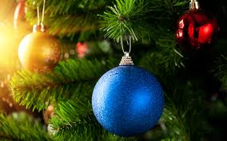
Merry Christmas!

Slide 2

Christmas Day, Christmas Day,
We are all glad and very gay!
We all dance, and sing and say,
“Welcome! Welcome!
Christmas Day!”

Slide 3
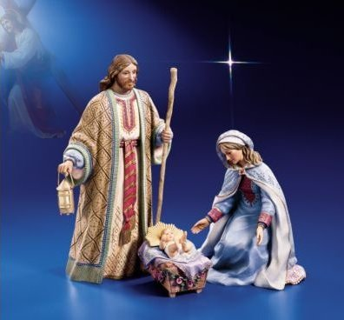
Christmas Day
is on the 25th
of December.

Slide 4
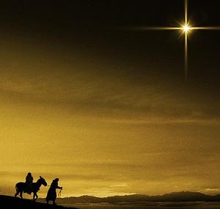
Mary and Joseph were Christ's parents.
They went to Bethlehem.
Their way was dangerous and very long.
It was getting darker and darker.

Slide 5
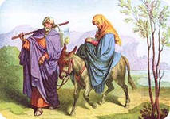
They didn't know where to go. A lot of bright stars appeared in the sky. Suddenly Mary saw a cave. “Let's have a sleep in this place,” she said to her husband.
.

Slide 6
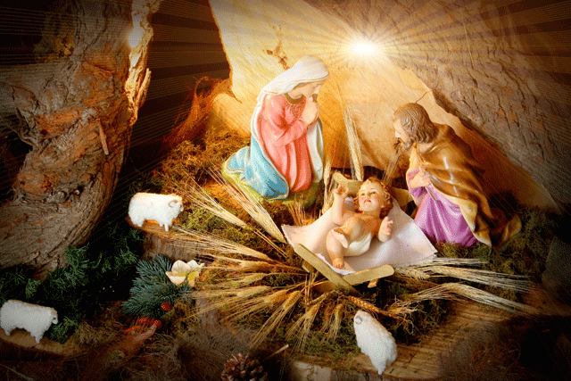
At last they found a place where Mary gave a birth
to her child. He was a boy.

Slide 7
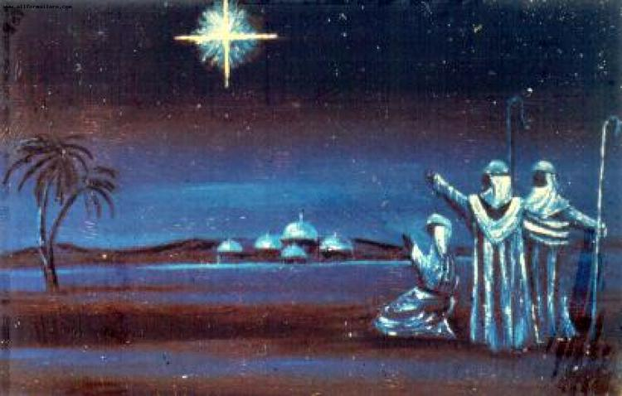
Many bright stars appeared
in the sky when Christ was born.
But among them was
the biggest and the
brightest star that showed
the way to his place of birth.

Slide 8
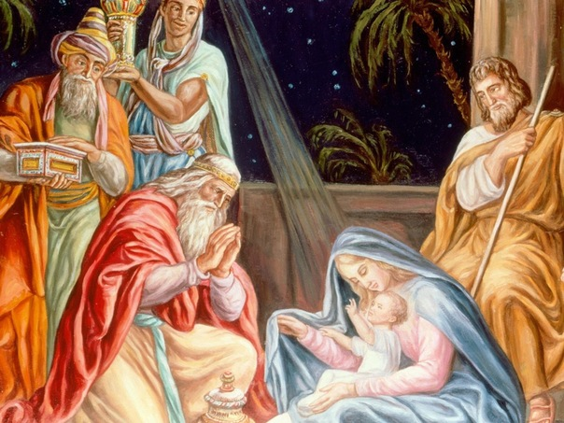
A lot of people came to see him.
They brought many presents for him.

Slide 9
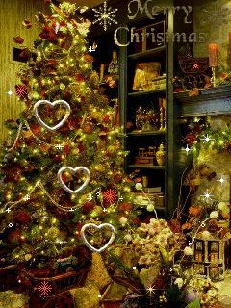
People decorate the evergreen tree with colorful balls, tinsel, lights and toys.

Slide 10
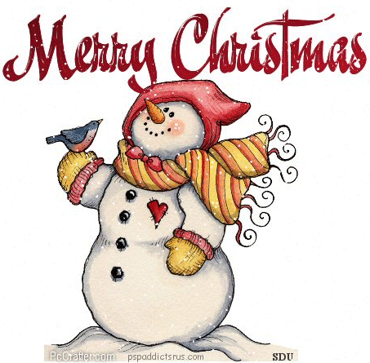
The snowman is one of Christmas symbols.
Look! We have a snowman.
He is tall and fat.
He has a carrot in his nose,
He has a funny hat.

Slide 11
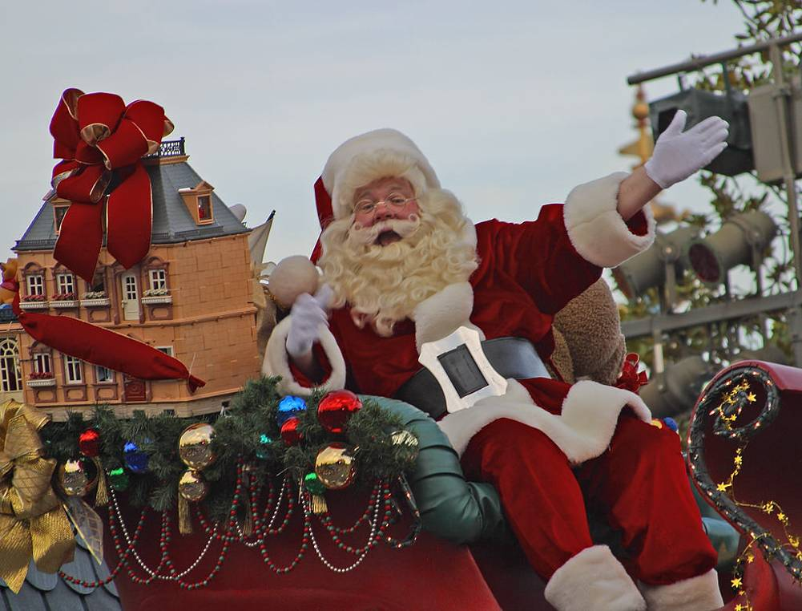
Santa Claus lives in England
He is funny and merry,
His cheeks are like roses,
His nose is like a cherry.

Slide 12
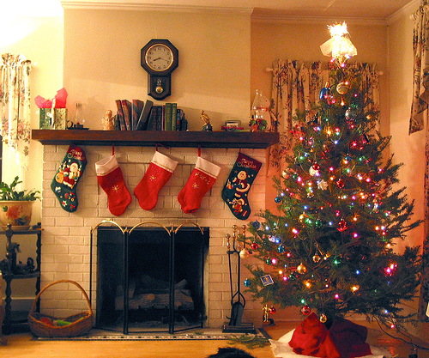
Children hang Christmas stockings on the fireplaces for their presents

Slide 13


Jingle Bells
Dashing through the snow
In a one-horse open sleigh,
Over the fields we go,
Laughing all the way;
Bells on bob-tail ring,
making spirits bright,
What fun it is to ride and sing
A sleighing song tonight, O
Jingle bells, jingle bells,
jingle all the way!
O what fun it is to ride
In a one-horse open sleigh.

Slide 14
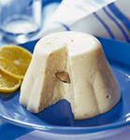
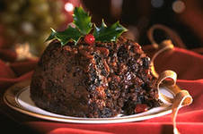
Christmas pudding is the highlight of Christmas dinner. Traditionally a coin is placed into the pudding. It brings good luck to a person.

Slide 15

People use candles, holly and mistletoe, evergreen plants, to decorate their homes.

Slide 16


